Slide 1
OCTOTOOL
Time Slot:
5:59 - 6:03 PM
Group Members:
Pranav Vanjani SID:3037396725
Michael Jia SID:3035673003
Matthew Chen SID:3035773870
Aaron Luo SID: 3034743752

Slide 2
Project Proposal
Develop a tool box that follows the user. This will primarily hold tools that a person needs to use or has. Kind of like a sentient robot toolbox that can provide tools on command. It will be able to park back into a slot when you turn it off or check out from work lets say. Basically an automated library but for tools.
Motivation:
We believe this will be useful for student teams and also technicians in industry where the use of tools are important and keeping it organized or accessible is requirement. This will save a lot of time usually wasted; looking for the toolkit and the right tool inside, increasing the overall working efficiency.

Slide 3
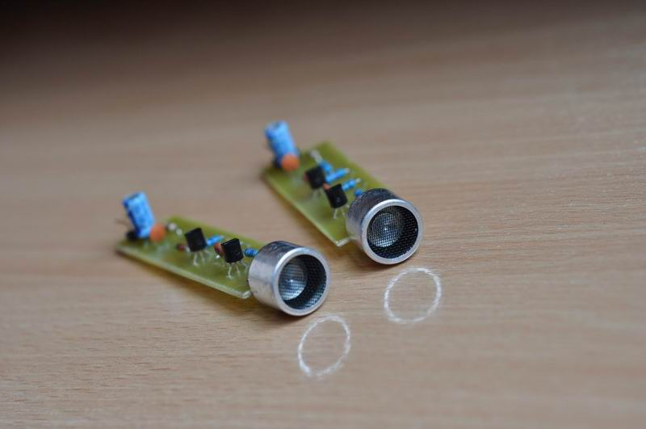
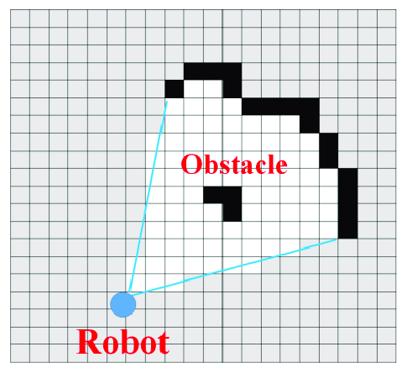
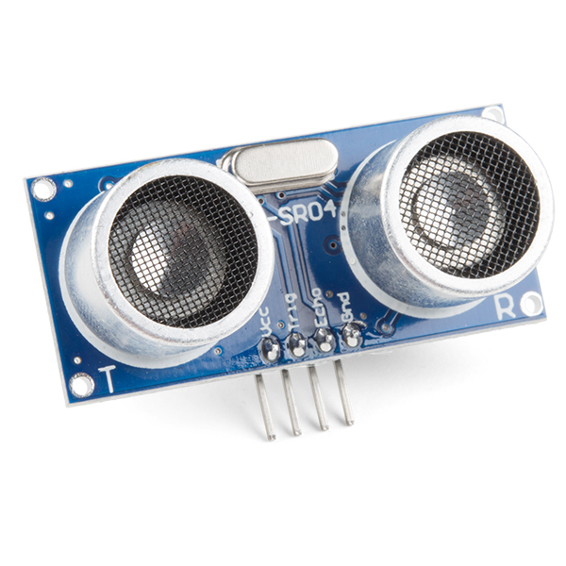
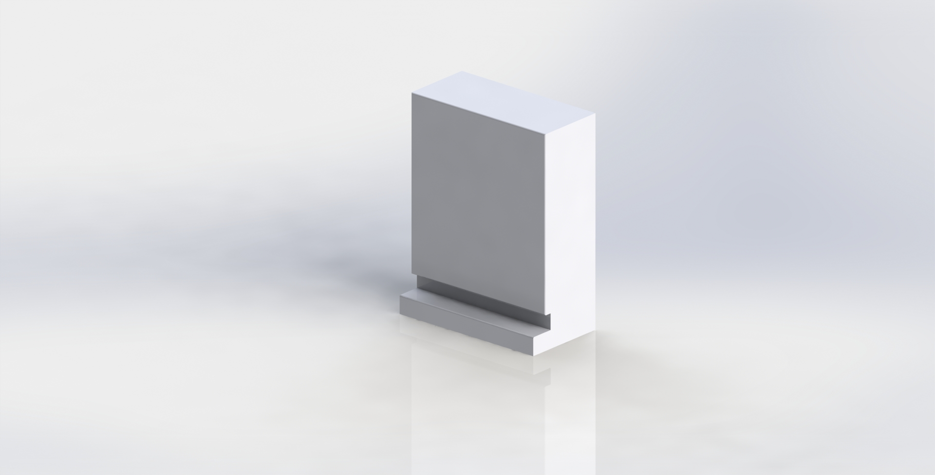
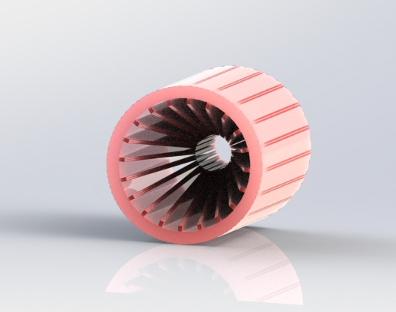
Real time component:
The Toolkit will follow the user using ultrasonic sensors and beacon detection.
Have real time obstacle detection using ultrasonic sensors, Occupancy grid method.
Multitasking elements:
The toolkit will follow the user
Have obstacle detection
Dispensing tools on demand using a conveyor system
Challenges:
Making universal tool dispenser
Programming obstacle detection
Ultrasonic beacon
Occupancy grid
Ultrasonic sensor
Toolkit
Universal tool holder

